Slide 1
S1 resolution and SER problems: part3
Сampaign V
Oleynikov Vladislav
28 Nov 2018

Slide 2
Algorithm:
11713f949ea5bffcc2f0ceb22d1267b5f314a5af
Merge branch 'barycenter' into 'master'

Slide 3
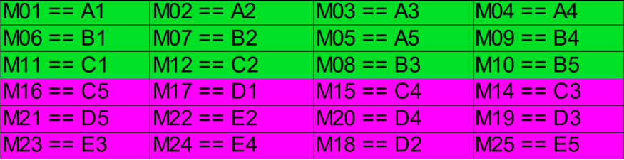
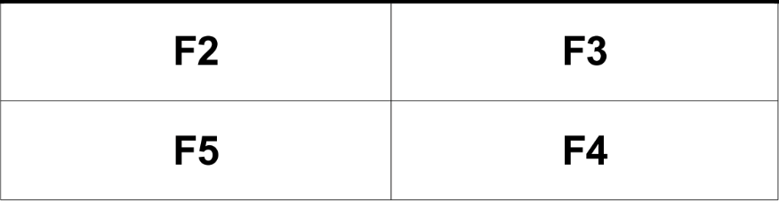
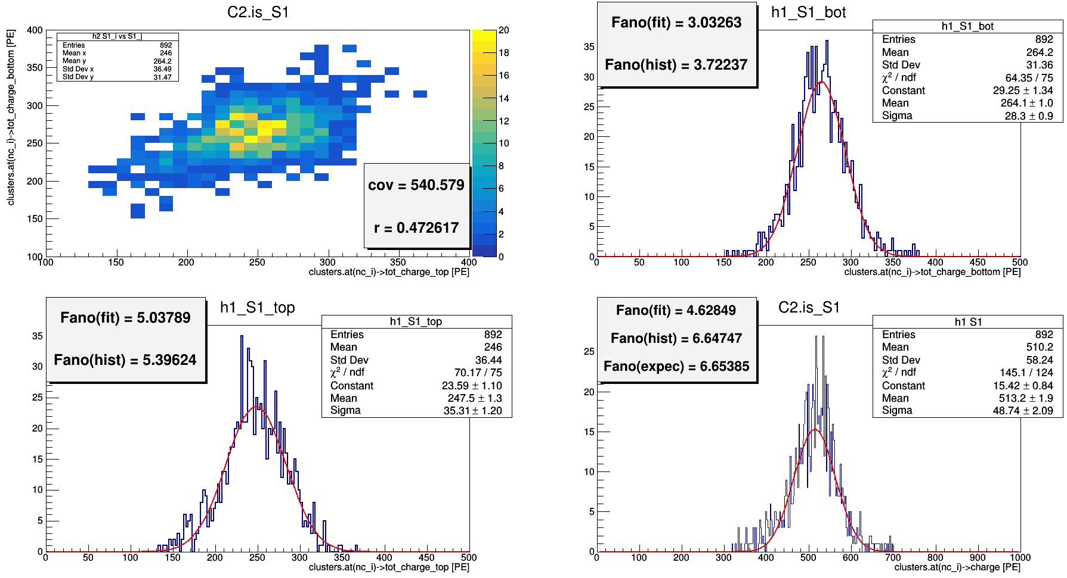
Ph2, Am241, run 537
fano_expec = (pow(rms_i, 2.0) + pow(rms_j, 2.0) + 2*cov_r[0])/(mean_i + mean_j);

Slide 4
double solid_angle_part = 0.5;
double PDE1 = 1;
double PDE2 = 1;
int Ns = 1;//sourse intensity and distribution
//int Ns = rndm3.Binomial(1, 0.5);
//int Ns = rndm3.Poisson(30);
double Ni0 = rndm3.Binomial(Ns, solid_angle_part);//num of photons emitted in the left part
double Nj0 = Ns - Ni0;//num of photons emitted in the right part
double Ni = rndm3.Binomial(Ni0, PDE1);//num of photons detected by the left part
double Nj = rndm3.Binomial(Nj0, PDE2);//num of photons detected by the right part

Slide 5
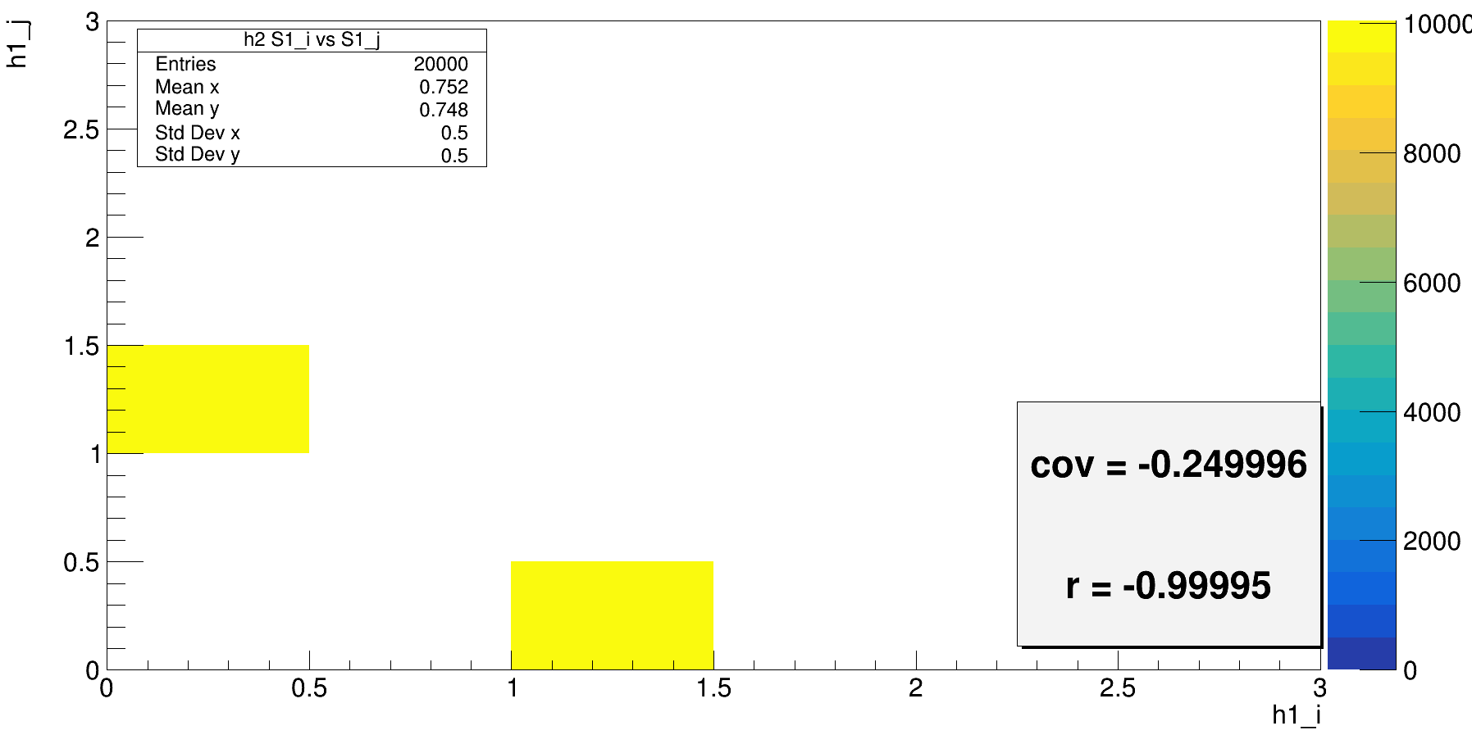
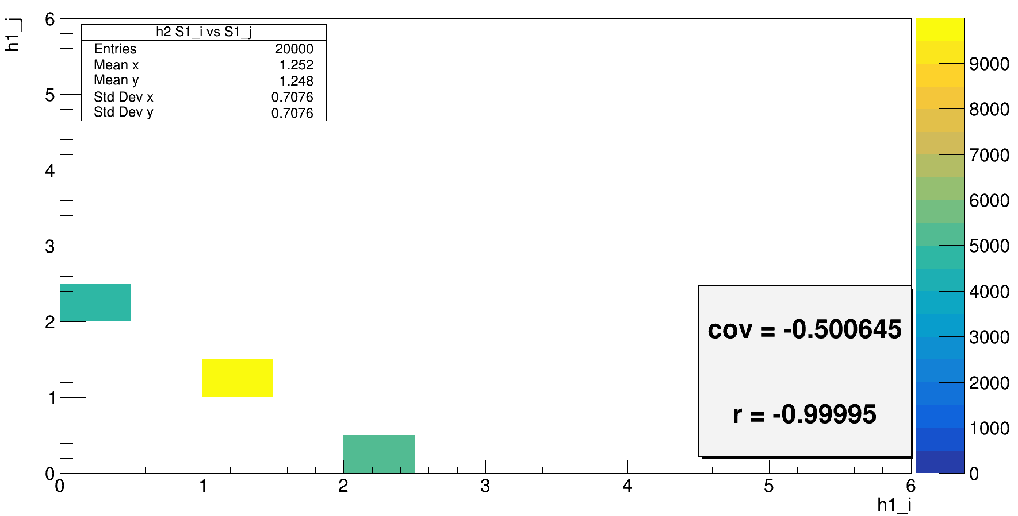
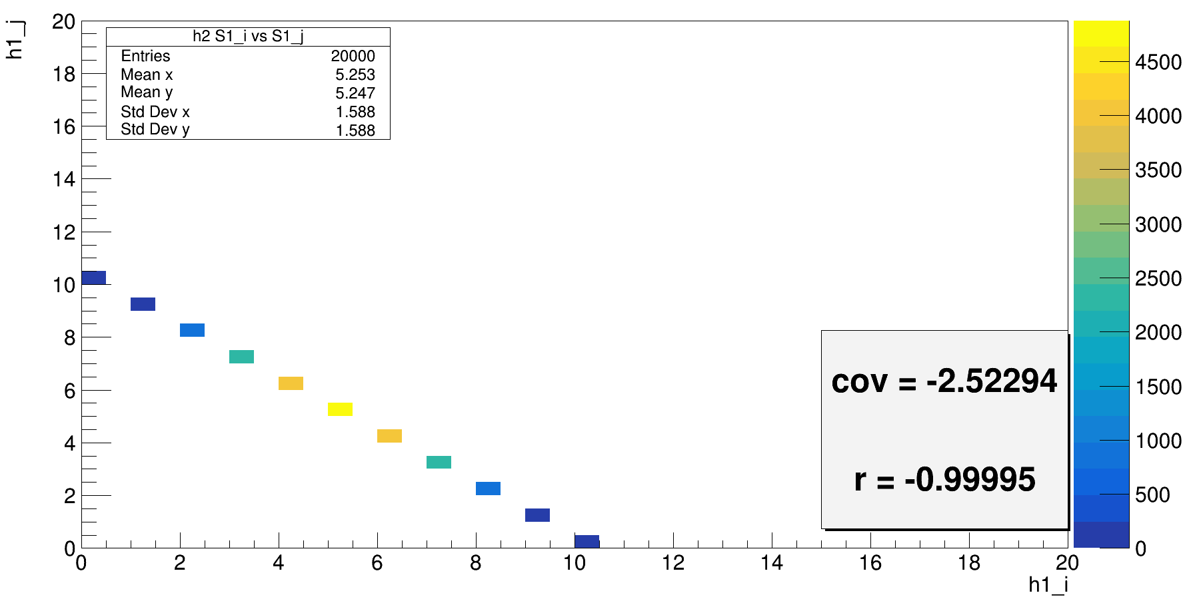
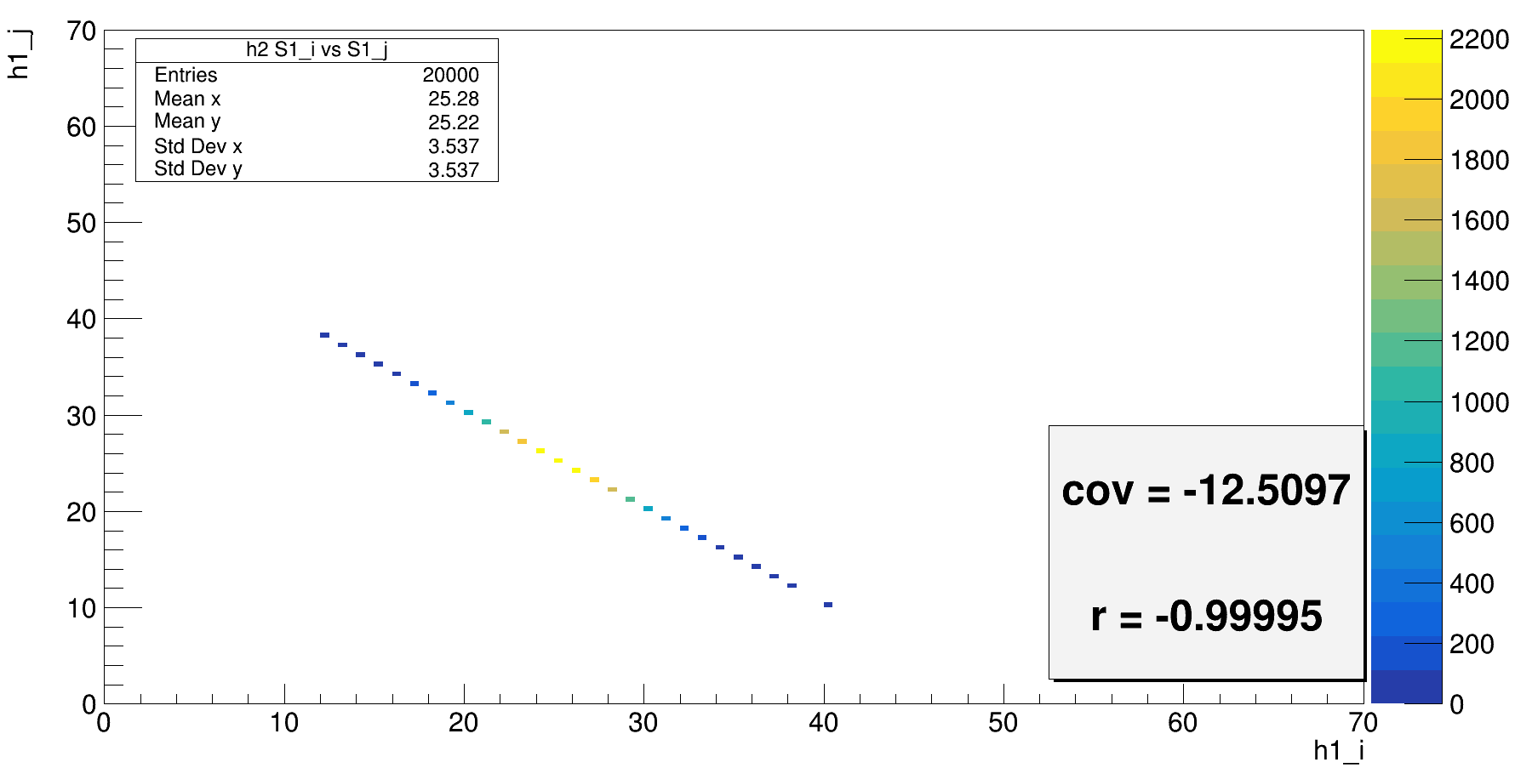
Ns = 1;
PDE1 = PDE2 = 1
Ns = 2;
PDE1 = PDE2 = 1
Ns = 10;
PDE1 = PDE2 = 1
Ns = 50;
PDE1 = PDE2 = 1
Ns = Ni + Nj; eff1 = PDE1 * solid_angle_part;
r(i, j) = - sqrt(eff1 * eff2) / sqrt( (1 – eff1) * (1 – eff2) )
If eff1 = eff2 = 0.5, then
r(i, j) = -1

Slide 6
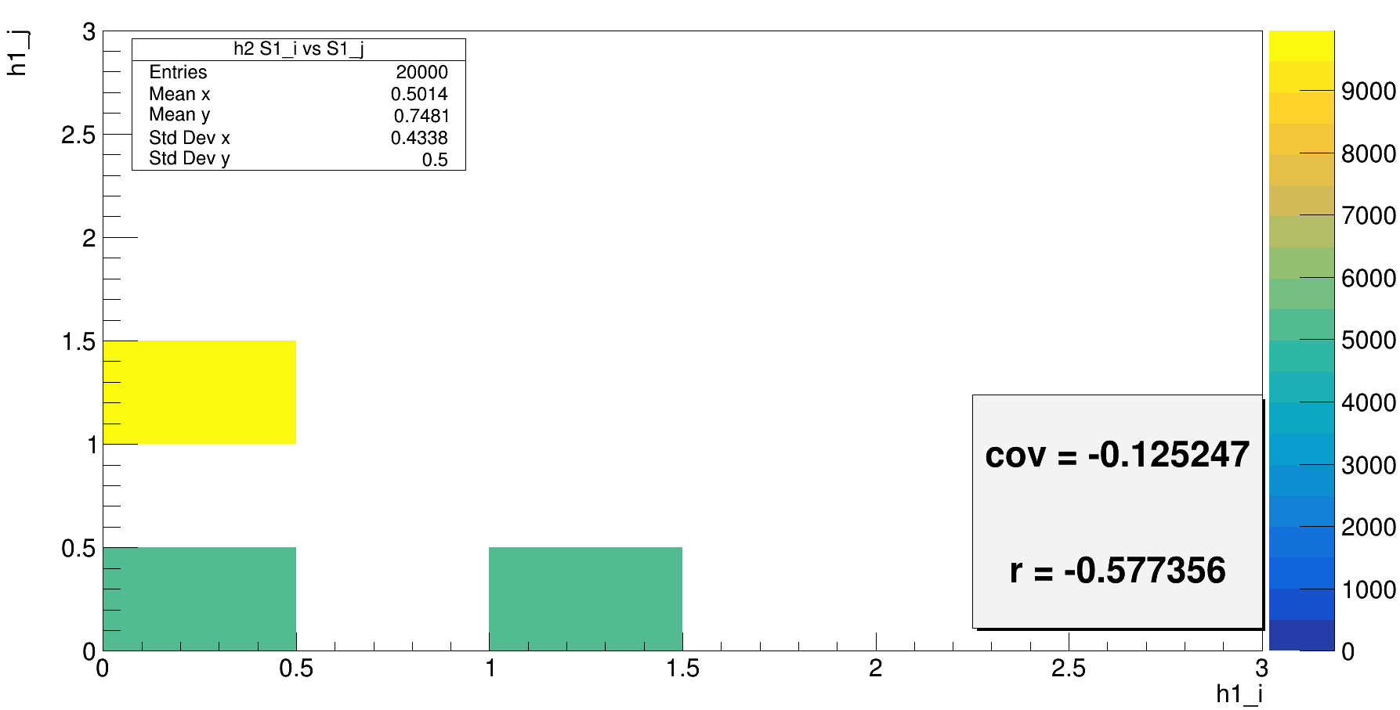
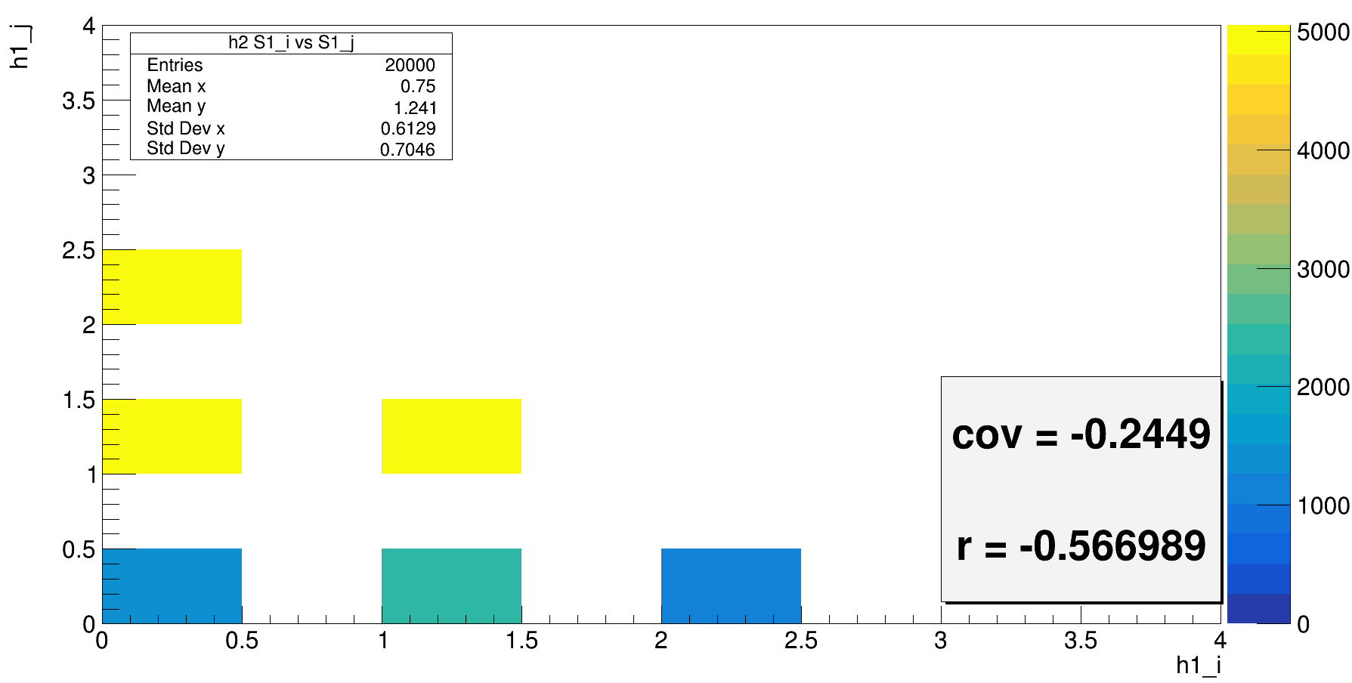
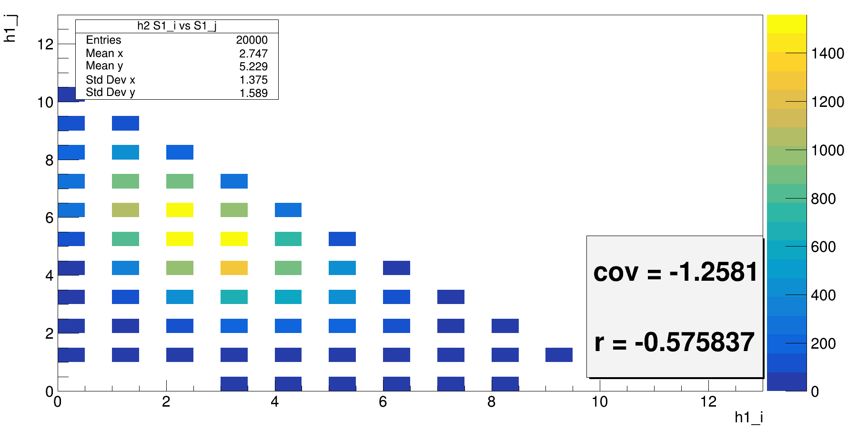
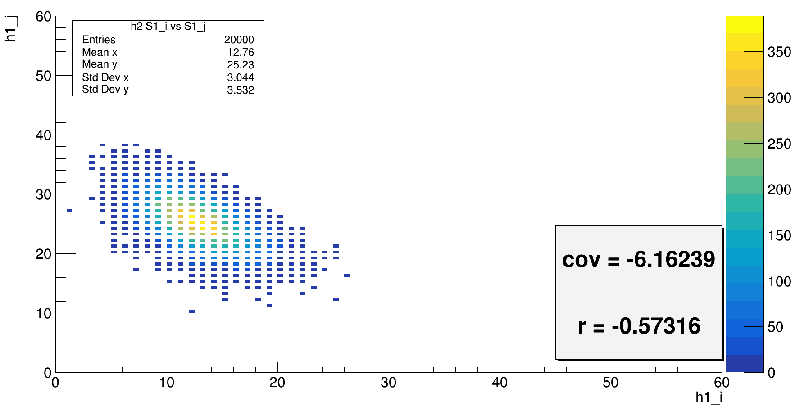
Ns = 1;
PDE1 = 0.5;
PDE2 = 1;
Ns = 2;
PDE1 = 0.5;
PDE2 = 1;
Ns = 10;
PDE1 = 0.5;
PDE2 = 1;
Ns = 50;
PDE1 = 0.5;
PDE2 = 1;

Slide 7
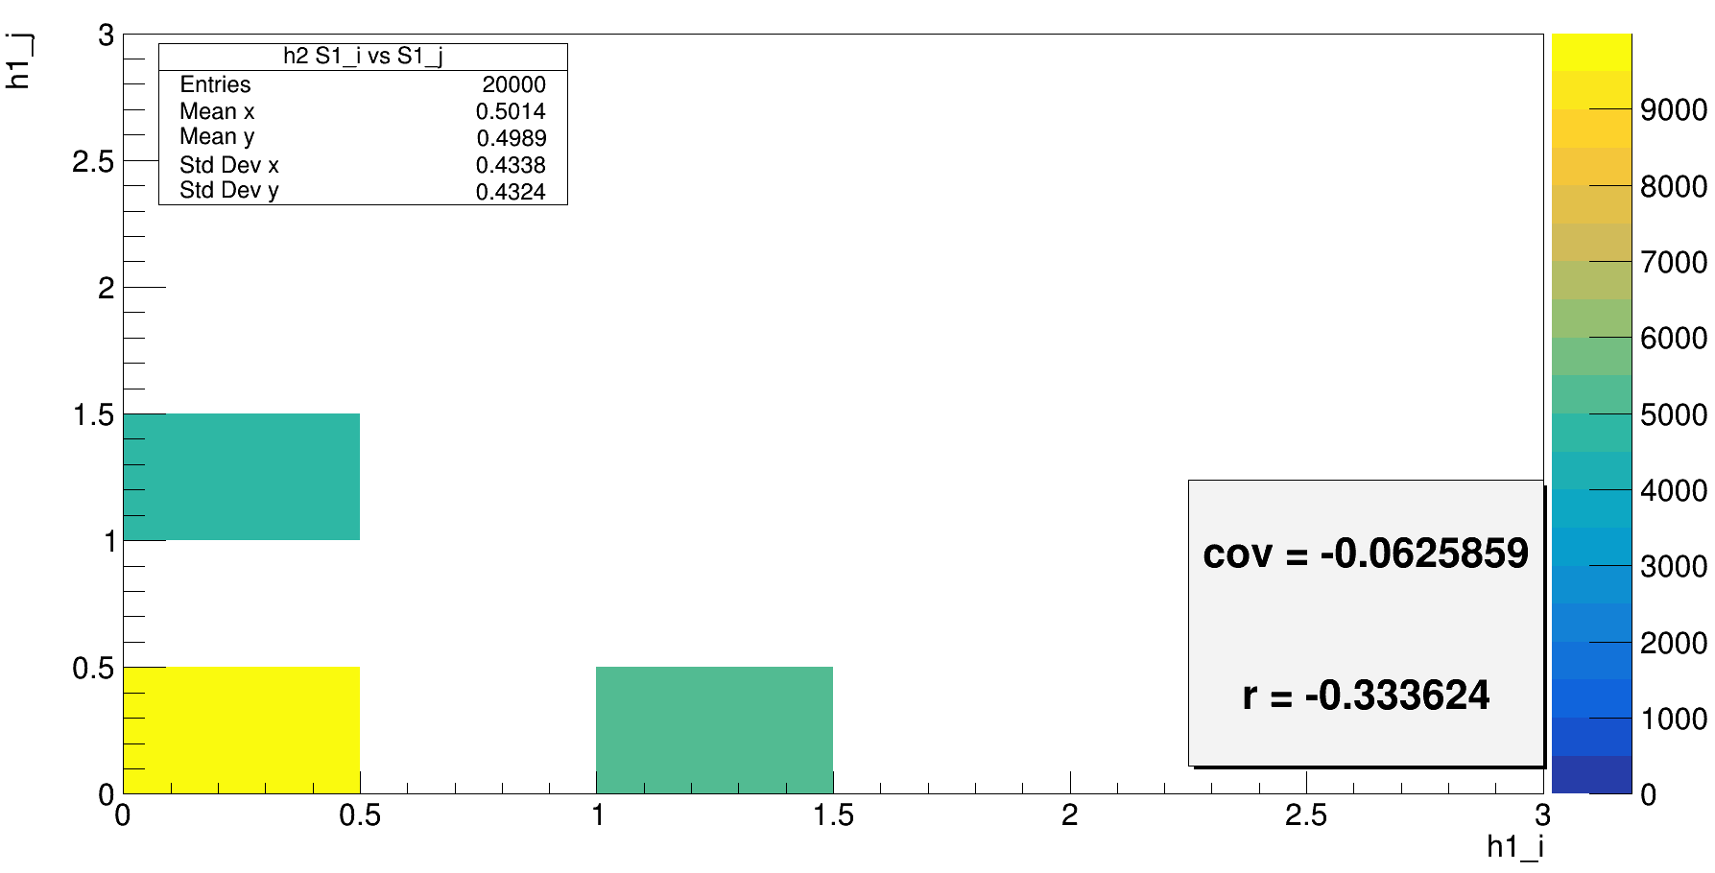
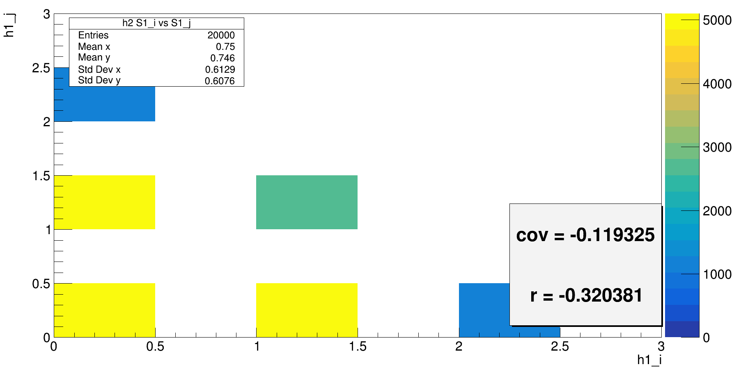
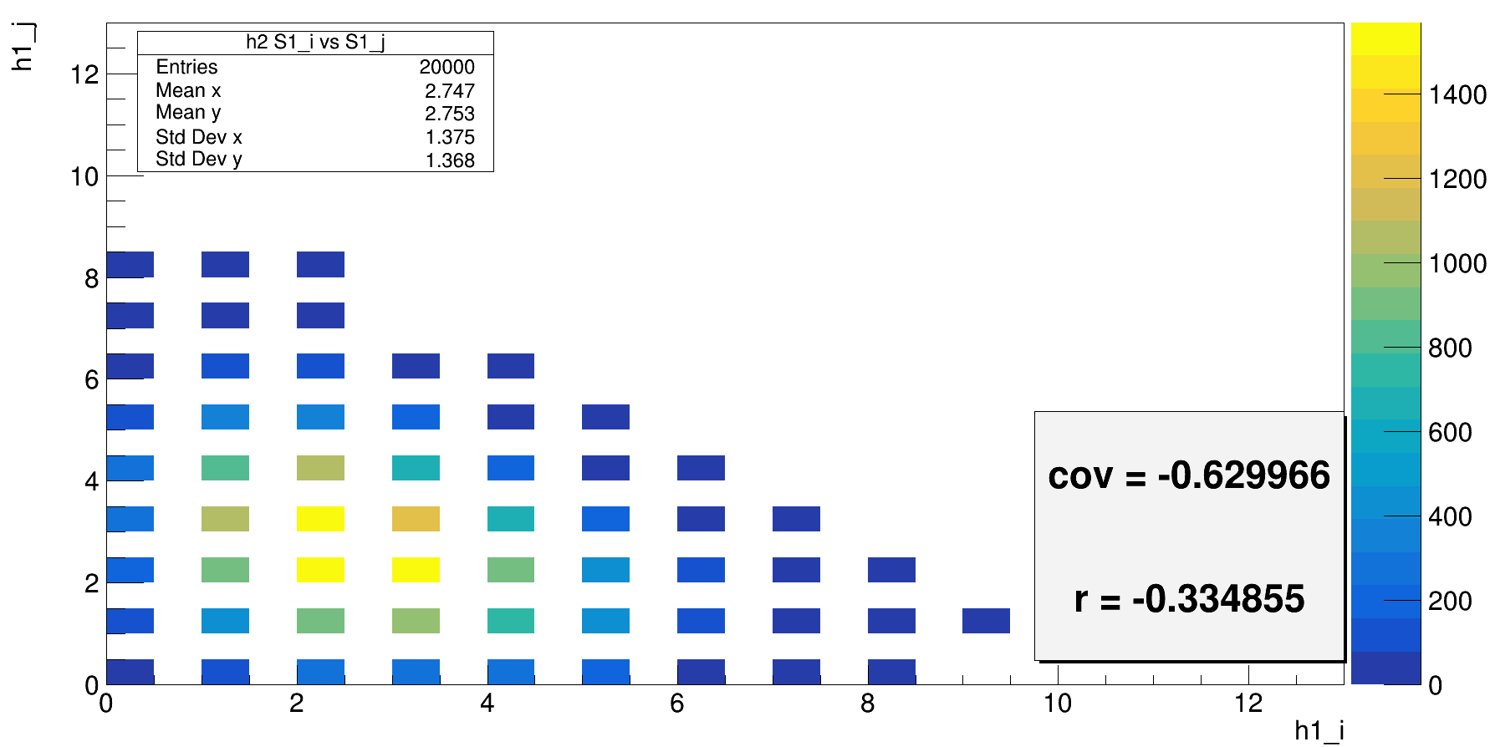
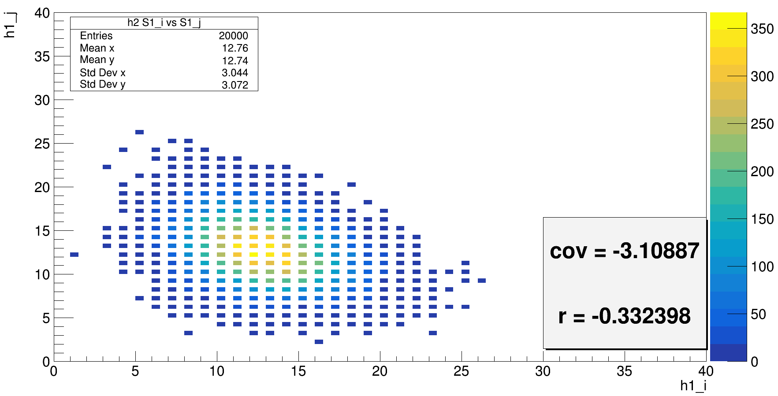
Ns = 1;
PDE1 = 0.5;
PDE2 = 0.5;
Ns = 2;
PDE1 = 0.5;
PDE2 = 0.5;
Ns = 10;
PDE1 = 0.5;
PDE2 = 0.5;
Ns = 50;
PDE1 = 0.5;
PDE2 = 0.5;

Slide 8
double solid_angle_part = 0.5;
double PDE1 = 1;
double PDE2 = 1;
//int Ns = 1;//sourse intensity and distribution
int Ns = rndm3.Binomial(1, 0.5);
//int Ns = rndm3.Poisson(30);
double Ni0 = rndm3.Binomial(Ns, solid_angle_part);//num of photons emitted in the left part
double Nj0 = Ns - Ni0;//num of photons emitted in the right part
double Ni = rndm3.Binomial(Ni0, PDE1);//num of photons detected by the left part
double Nj = rndm3.Binomial(Nj0, PDE2);//num of photons detected by the right part

Slide 9

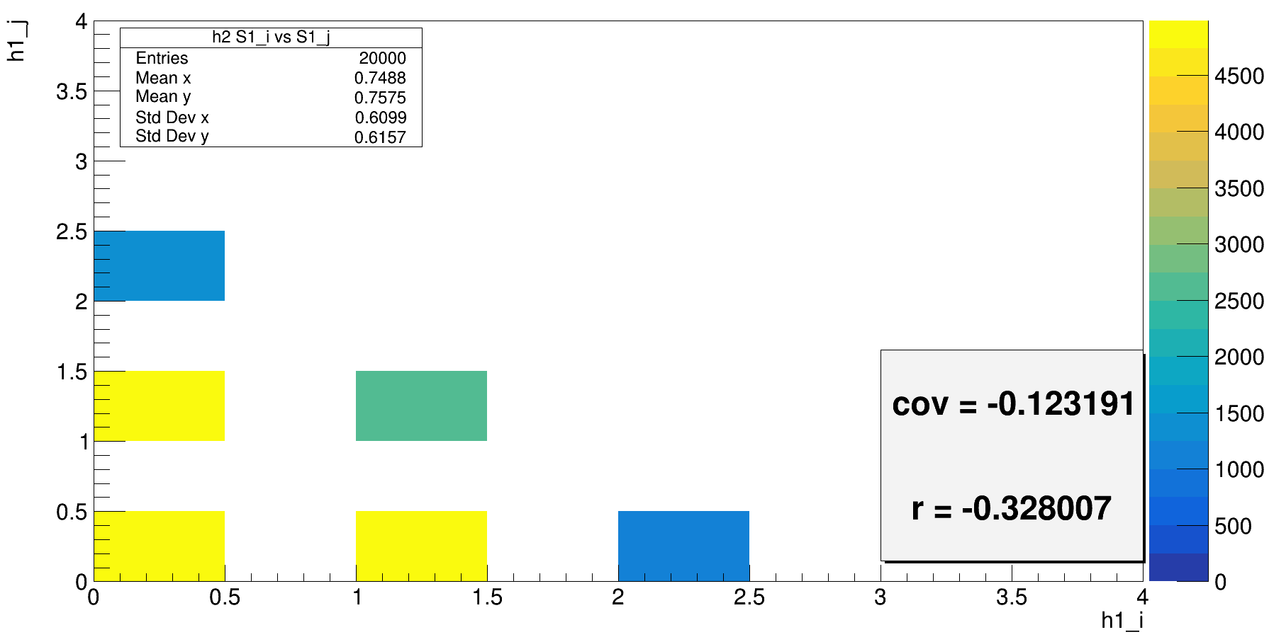
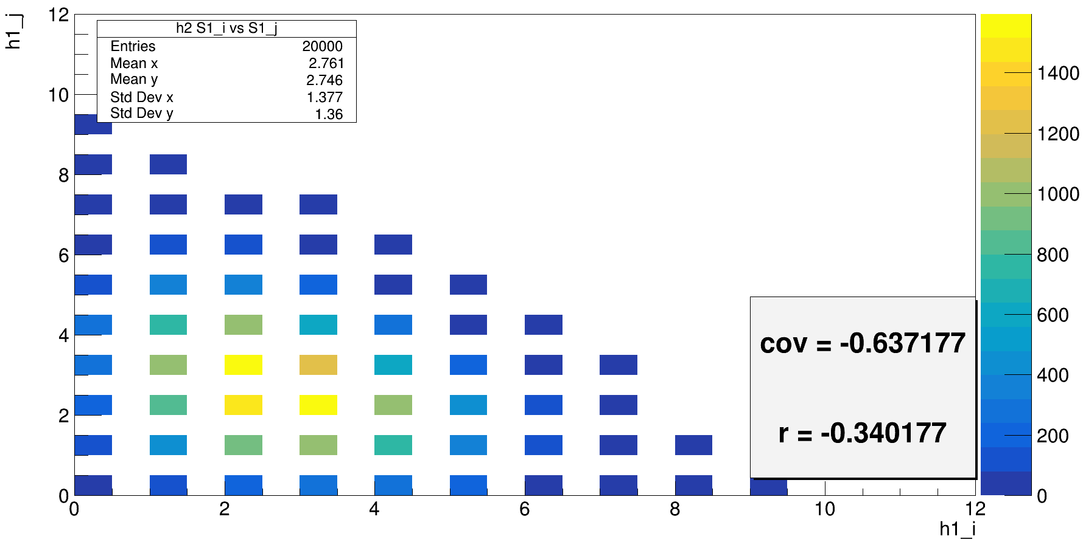
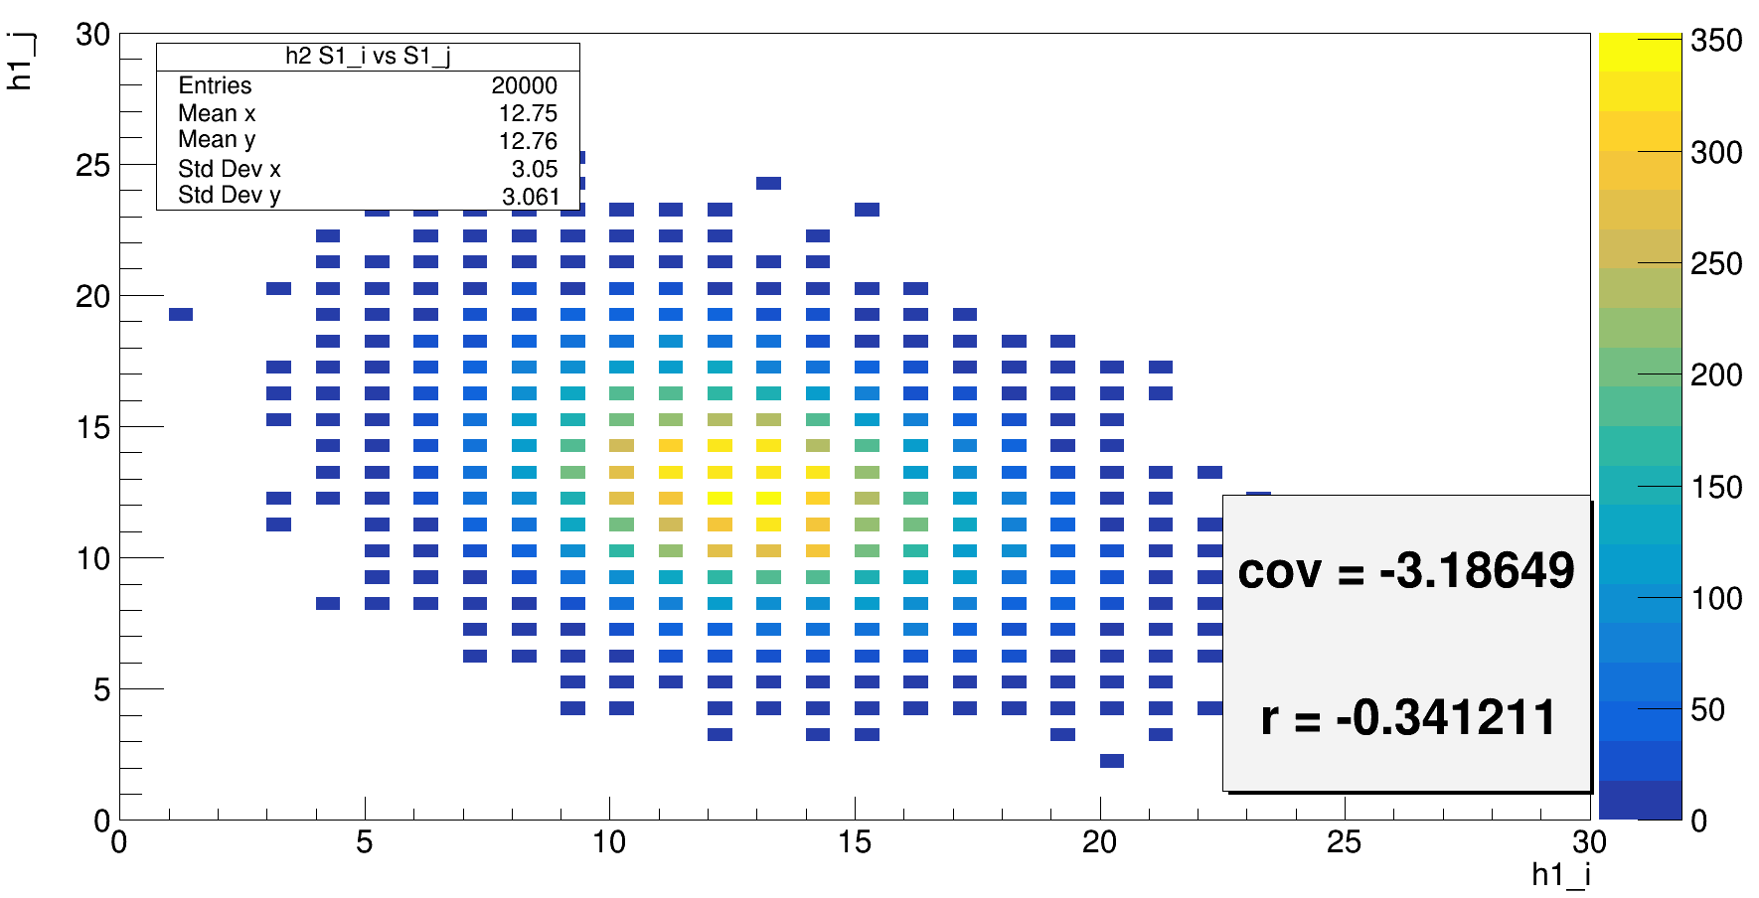
Ns = Binomial(1, 0.5);
PDE1 = 1;
PDE2 = 1;
Ns = Binomial(2, 0.5);
PDE1 = 1;
PDE2 = 1;
Ns = Binomial(50, 0.5);
PDE1 = 1;
PDE2 = 1;
Ns = Binomial(10, 0.5);
PDE1 = 1;
PDE2 = 1;

Slide 10
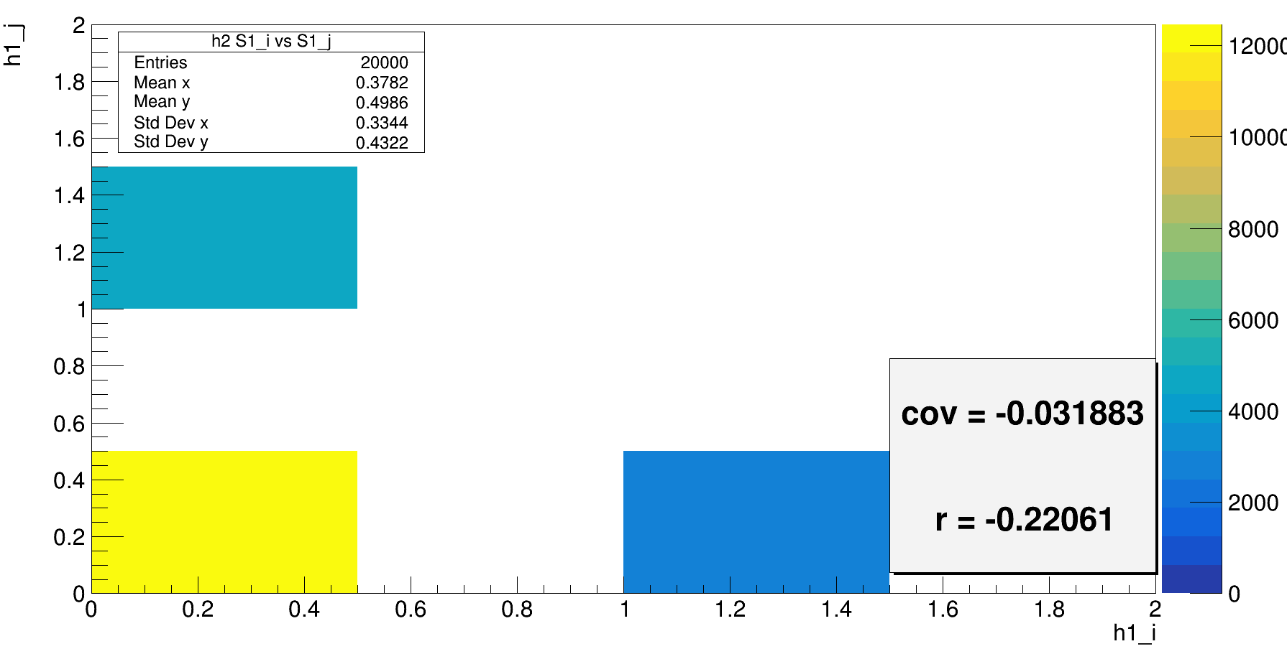
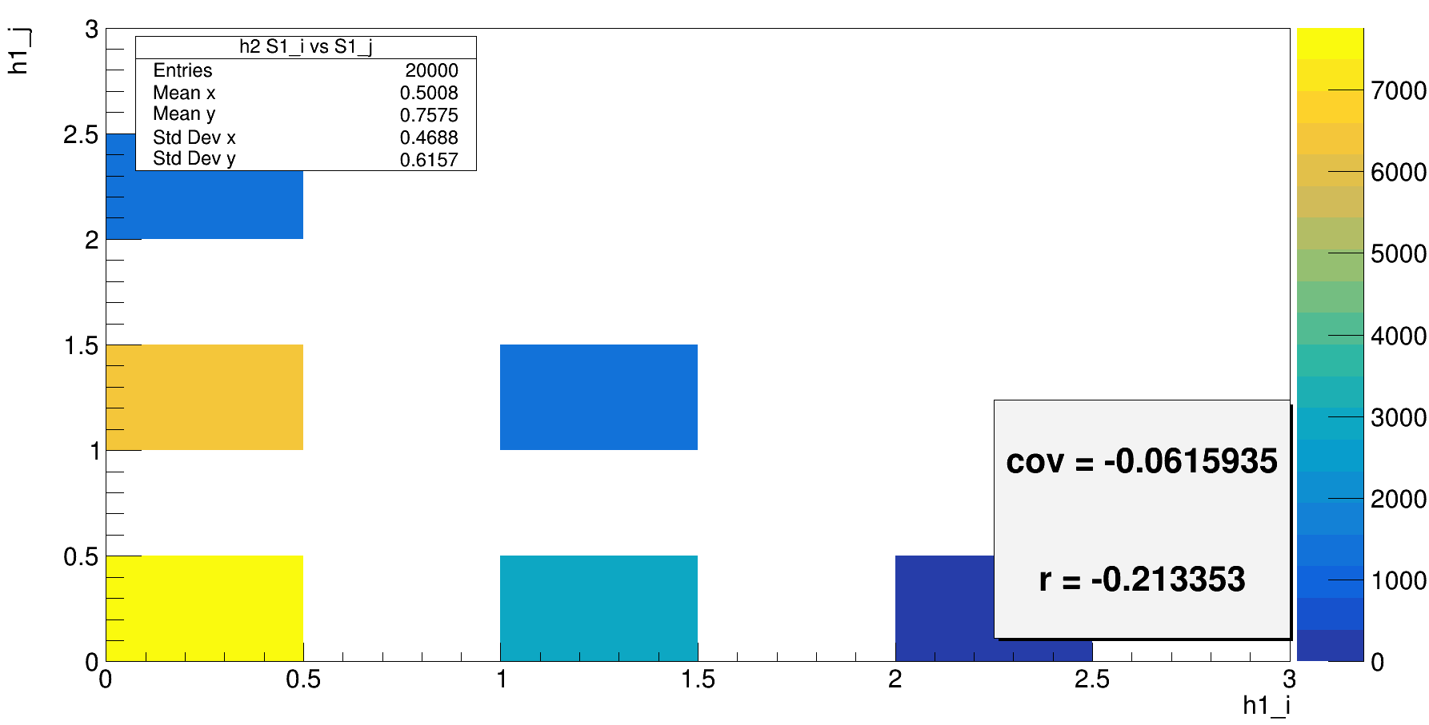
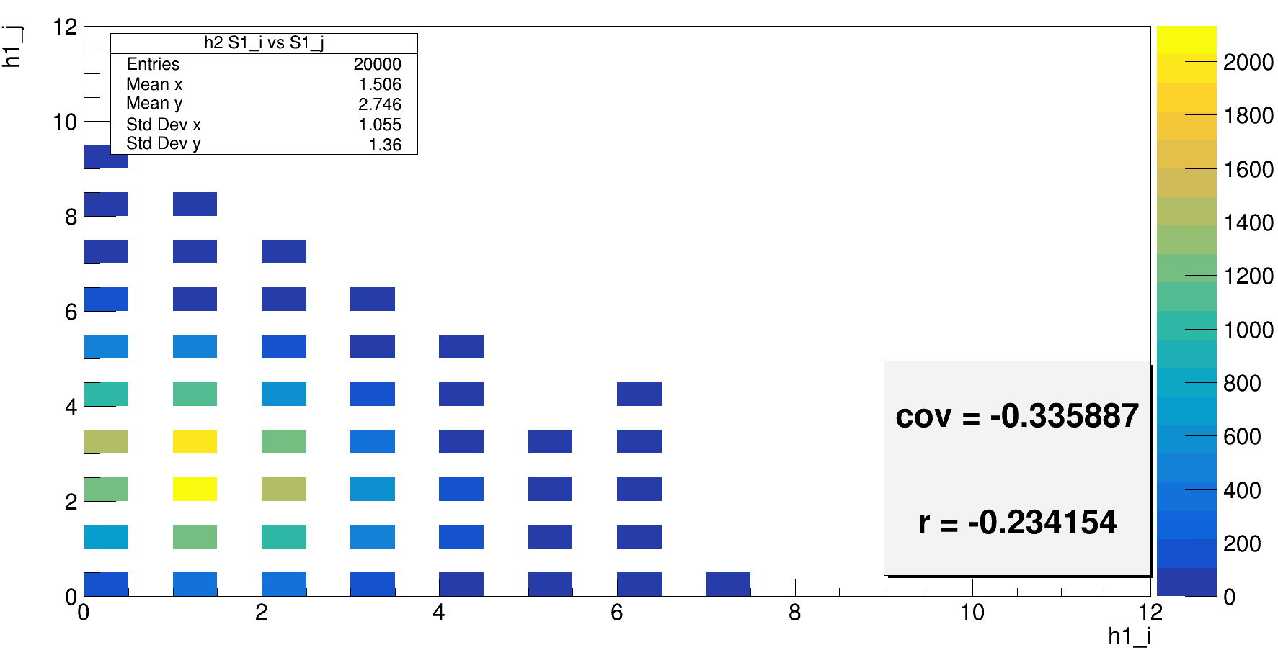
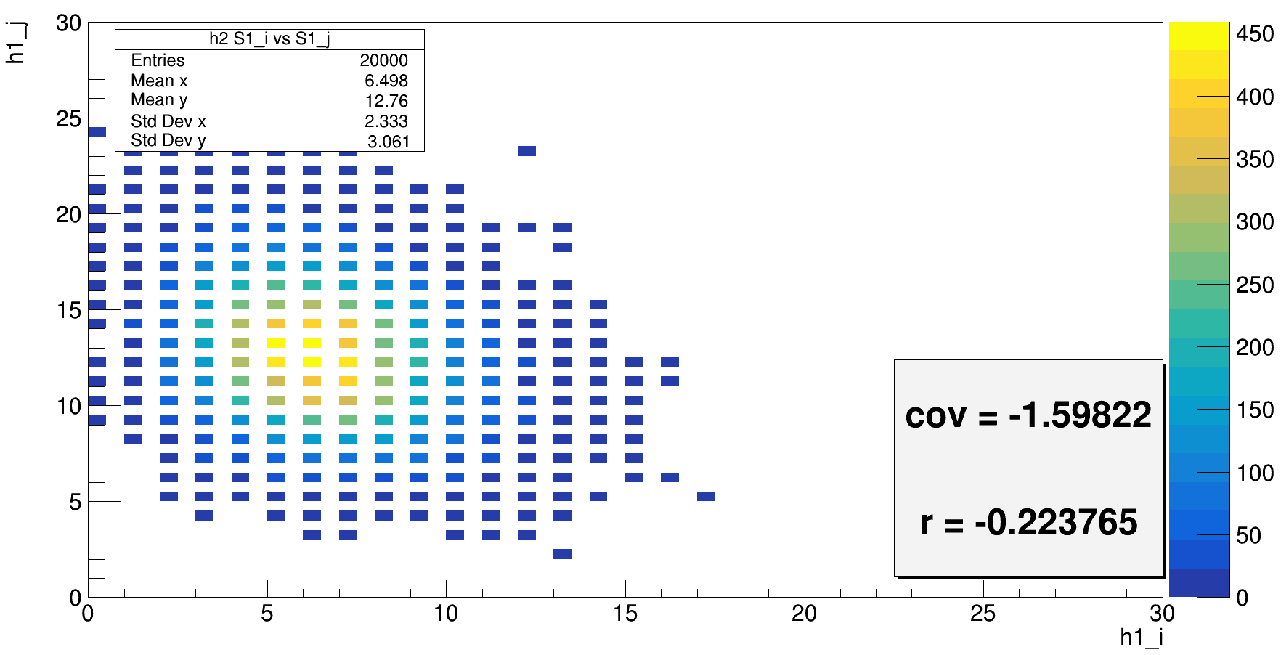
Ns = Binomial(1, 0.5);
PDE1 = 0.5;
PDE2 = 1;
Ns = Binomial(2, 0.5);
PDE1 = 0.5;
PDE2 = 1;
Ns = Binomial(10, 0.5);
PDE1 = 0.5;
PDE2 = 1;
Ns = Binomial(50, 0.5);
PDE1 = 0.5;
PDE2 = 1;

Slide 11
double solid_angle_part1 = 0.5;
double solid_angle_part2 = 0.5;
double PDE1 = 1;
double PDE2 = 1;
//int Ns = 60;//sourse intensity and distribution
int Ns = rndm3.Binomial(1, 0.5);
//int Ns = rndm3.Poisson(100);//sourse intensity and distribution
double Ni0 = rndm3.Binomial(Ns, solid_angle_part1);//num of photons emitted in the left part
//double Nj0 = Ns - Ni0;//num of photons emitted in the right part
double Nj0 = rndm3.Binomial(Ns - Ni0, solid_angle_part2);
double Ni = rndm3.Binomial(Ni0, PDE1);//num of photons detected by the left part
double Nj = rndm3.Binomial(Nj0, PDE2);//num of photons detected by the right part

Slide 12
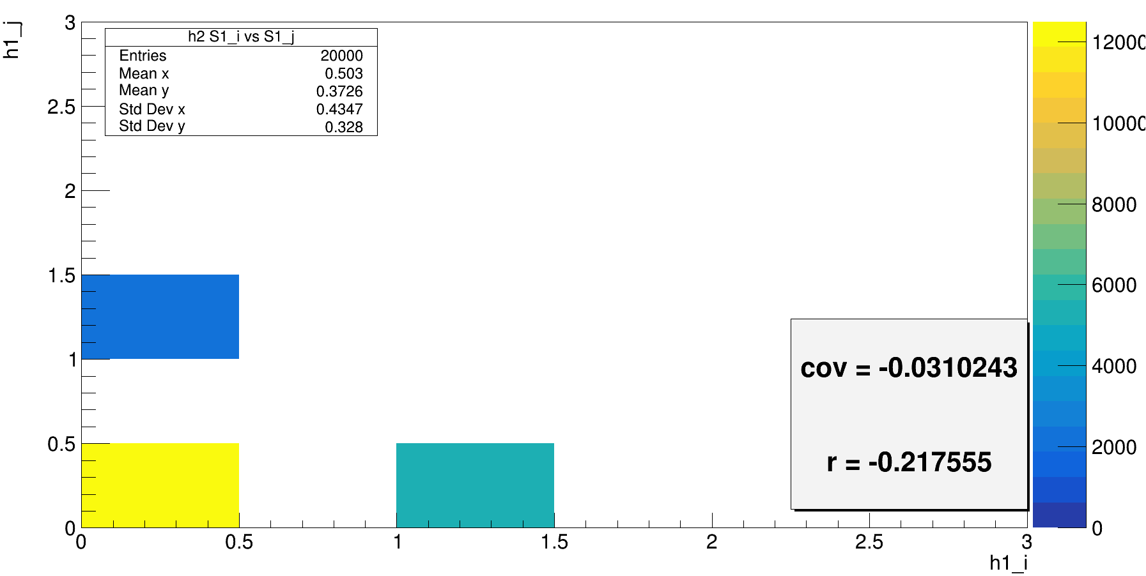
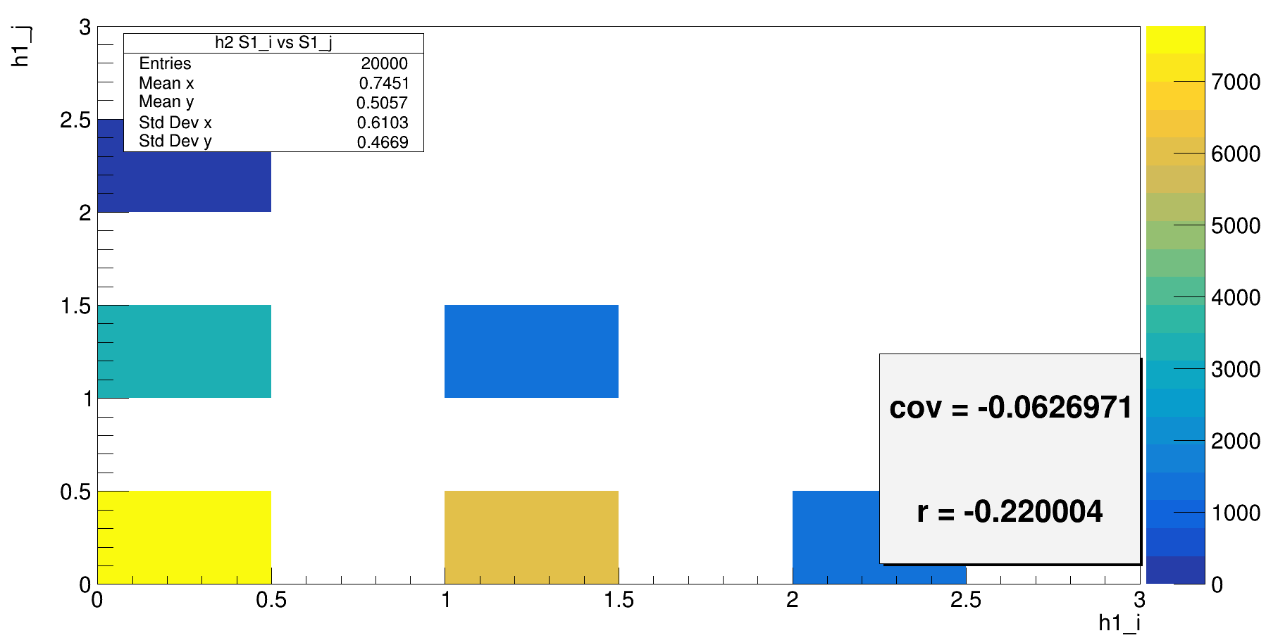
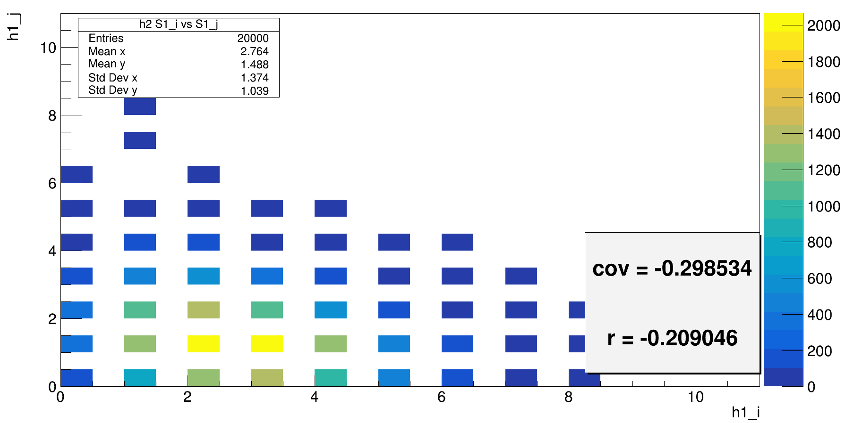
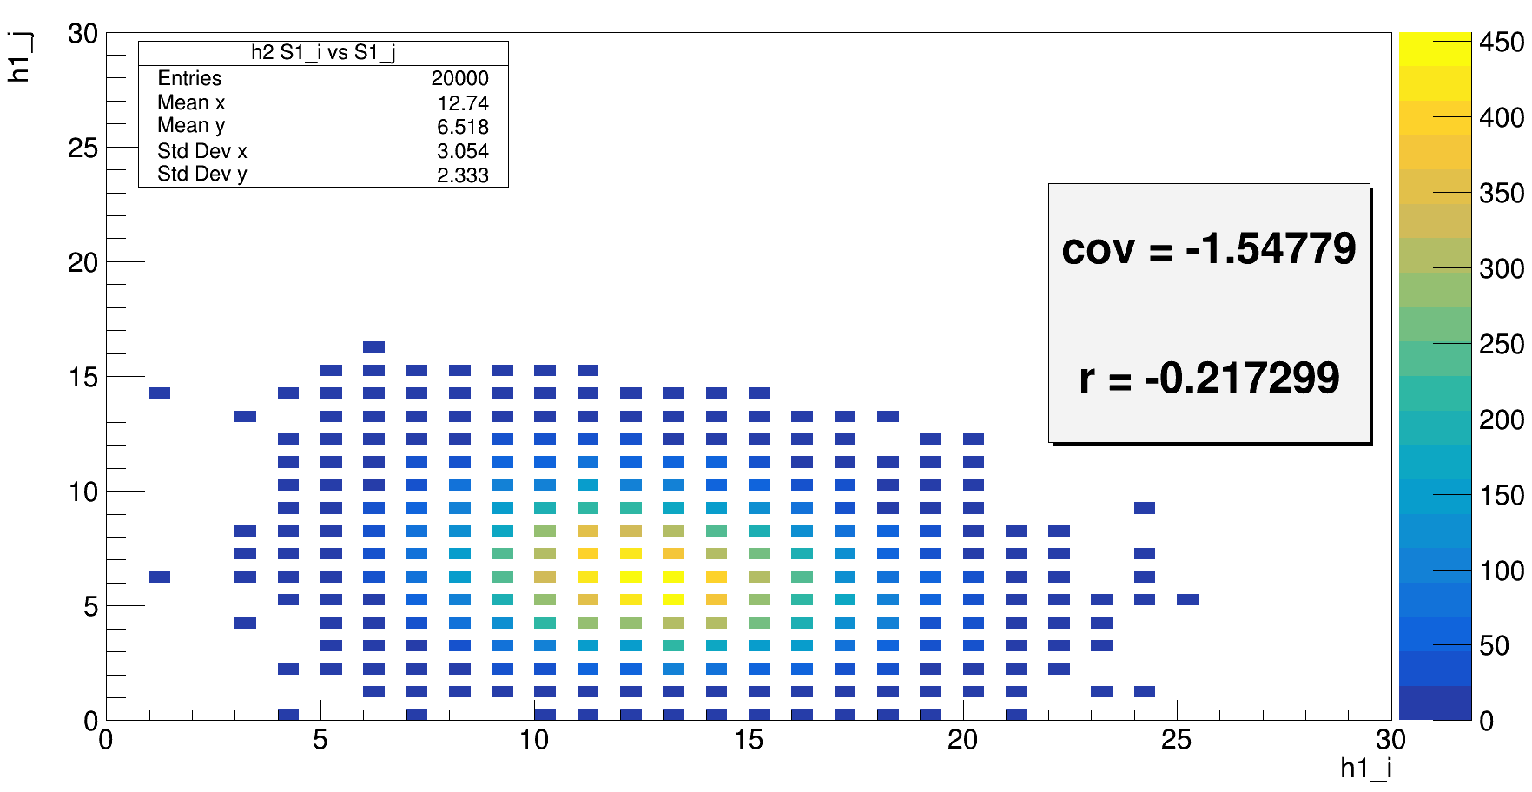
Ns = Binomial(1, 0.5);
PDE1 = 1;
PDE2 = 1;
Ns = Binomial(2, 0.5);
PDE1 = 1;
PDE2 = 1;
Ns = Binomial(50, 0.5);
PDE1 = 1;
PDE2 = 1;
Ns = Binomial(10, 0.5);
PDE1 = 1;
PDE2 = 1;

Slide 13
double solid_angle_part1 = 0.5;
double solid_angle_part2 = 0.5;
double PDE1 = 1;
double PDE2 = 1;
//int Ns = 60;//sourse intensity and distribution
//int Ns = rndm3.Binomial(1, 0.5);
int Ns = rndm3.Poisson(1);//sourse intensity and distribution
double Ni0 = rndm3.Binomial(Ns, solid_angle_part1);//num of photons emitted in the left part
double Nj0 = Ns - Ni0;//num of photons emitted in the right part
//double Nj0 = rndm3.Binomial(Ns - Ni0, solid_angle_part2);
double Ni = rndm3.Binomial(Ni0, PDE1);//num of photons detected by the left part
double Nj = rndm3.Binomial(Nj0, PDE2);//num of photons detected by the right part

Slide 14
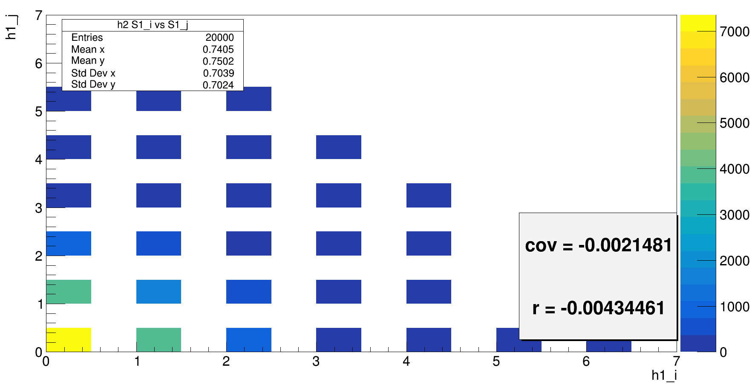
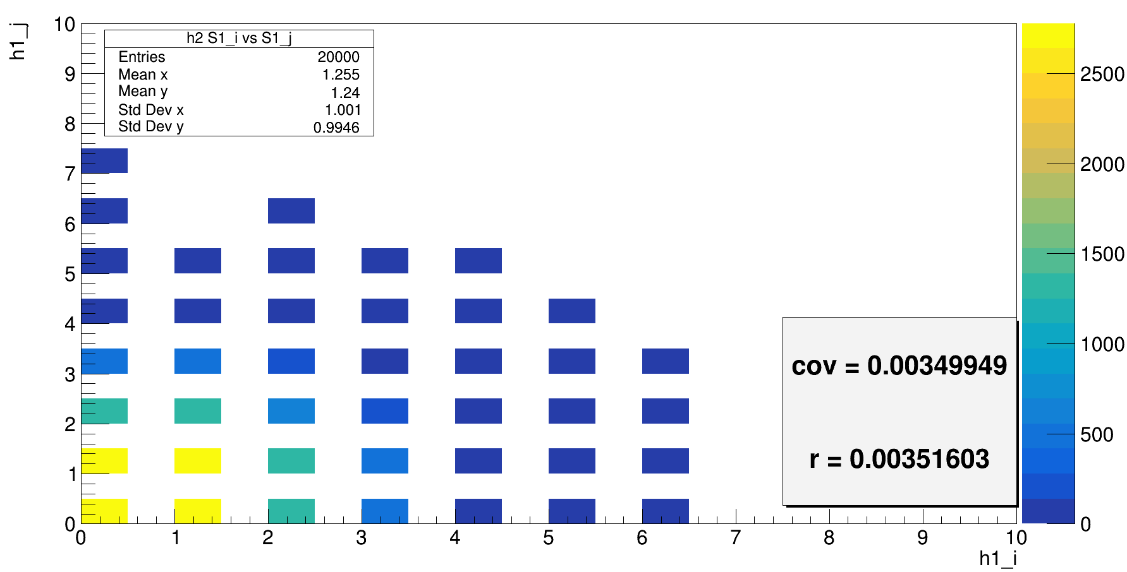
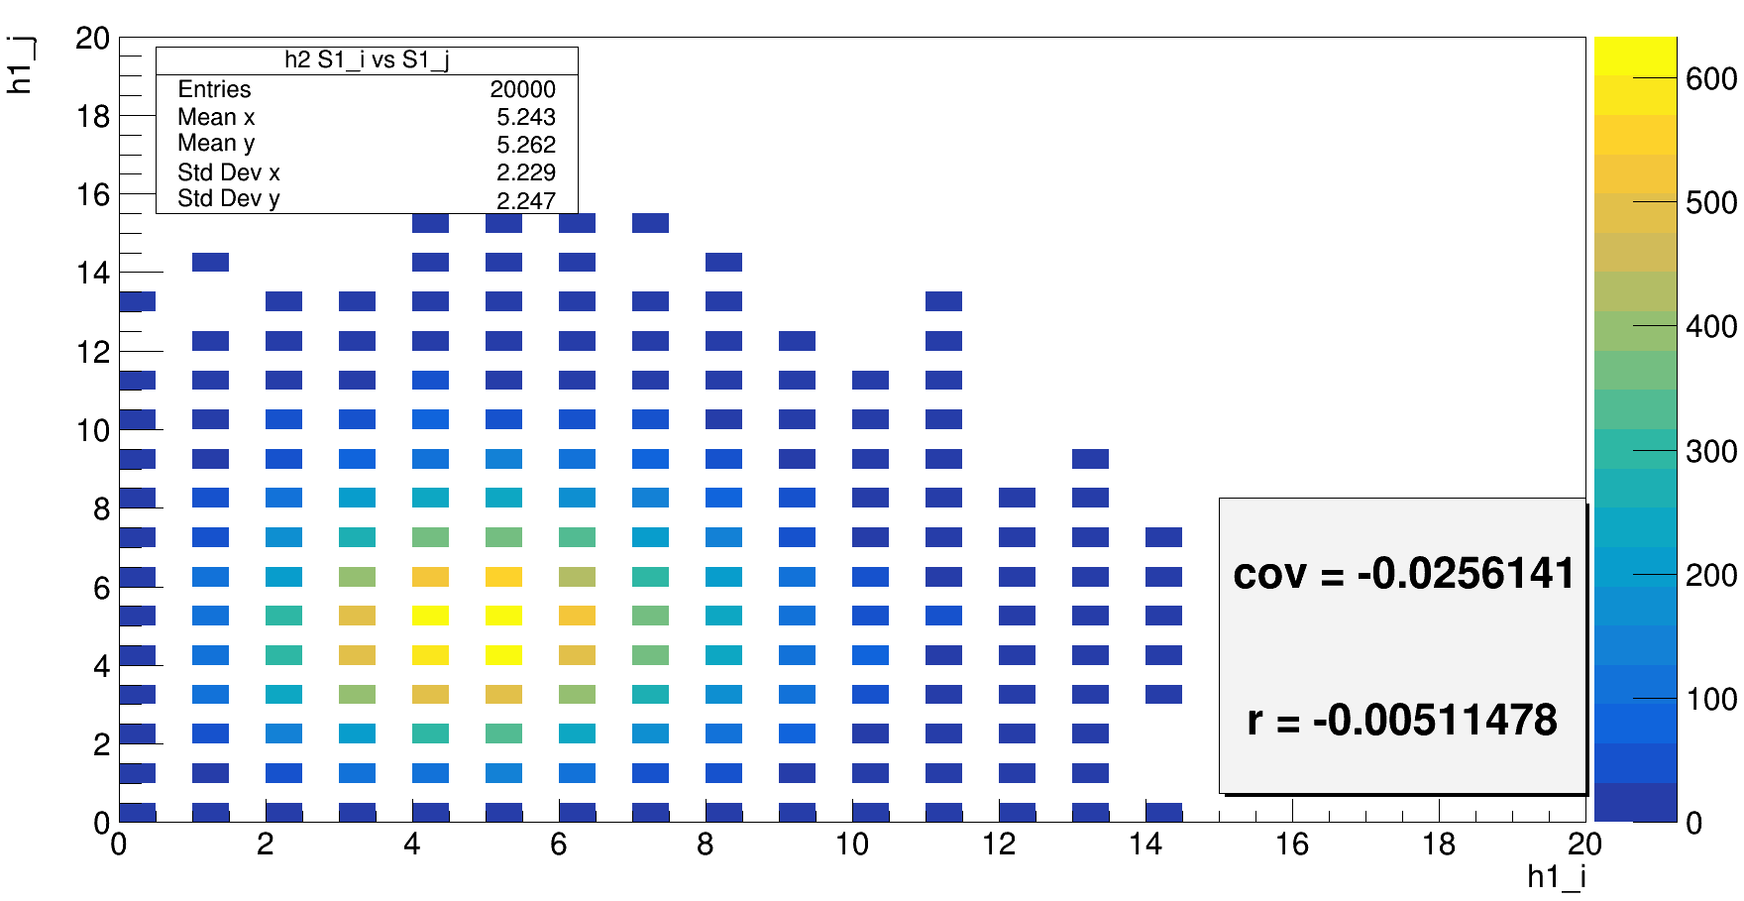
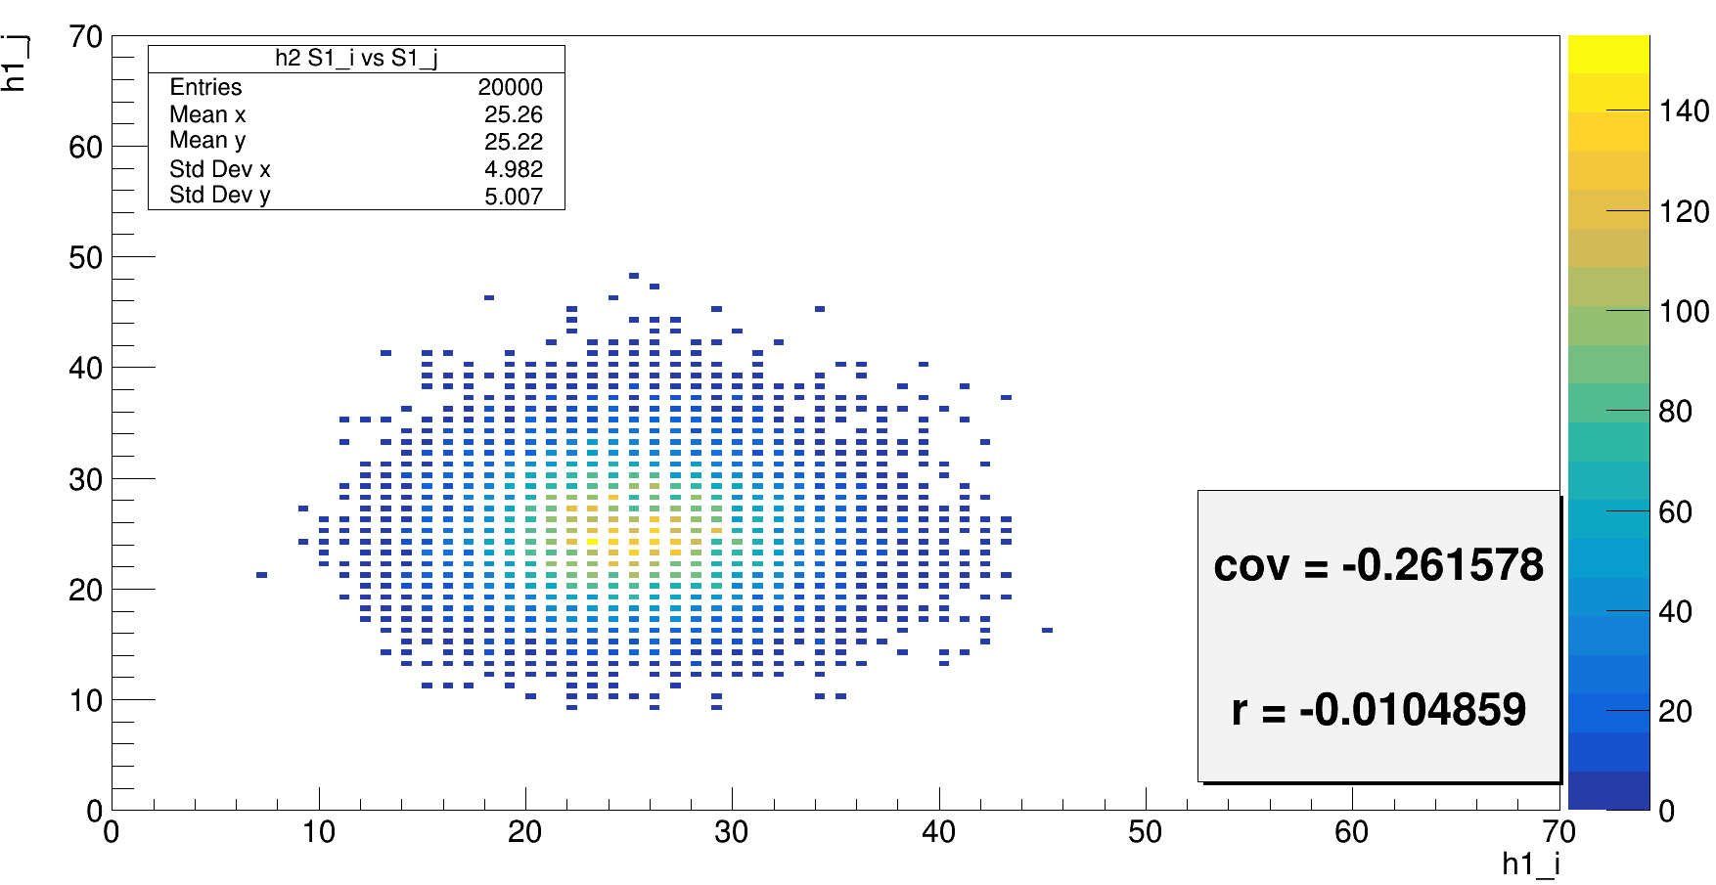
Ns = Poisson(1);
PDE1 = 1;
PDE2 = 1;
Ns = Poisson(2);
PDE1 = 1;
PDE2 = 1;
Ns = Poisson(50);
PDE1 = 1;
PDE2 = 1;
Ns = Poisson(10);
PDE1 = 1;
PDE2 = 1;

Slide 15
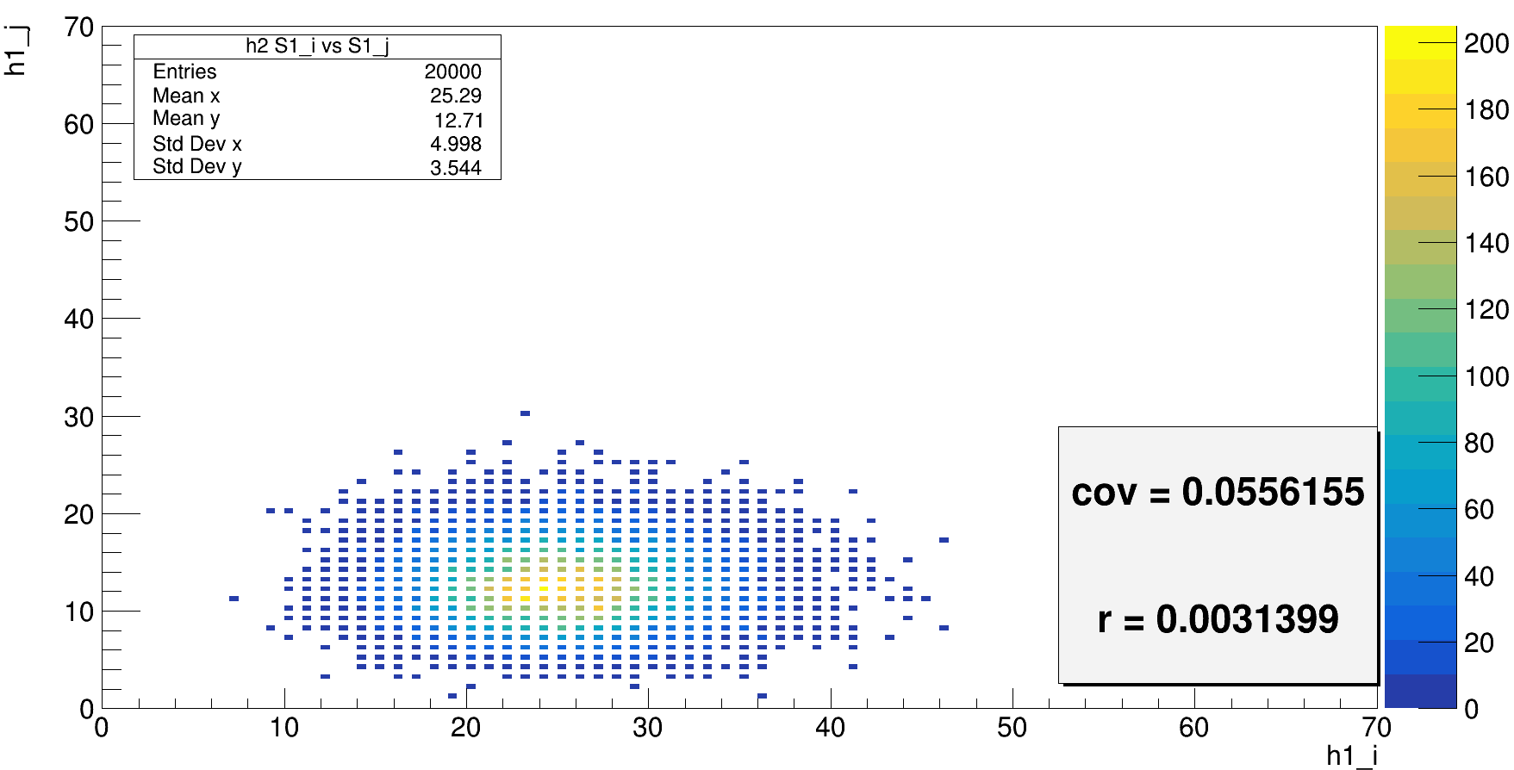
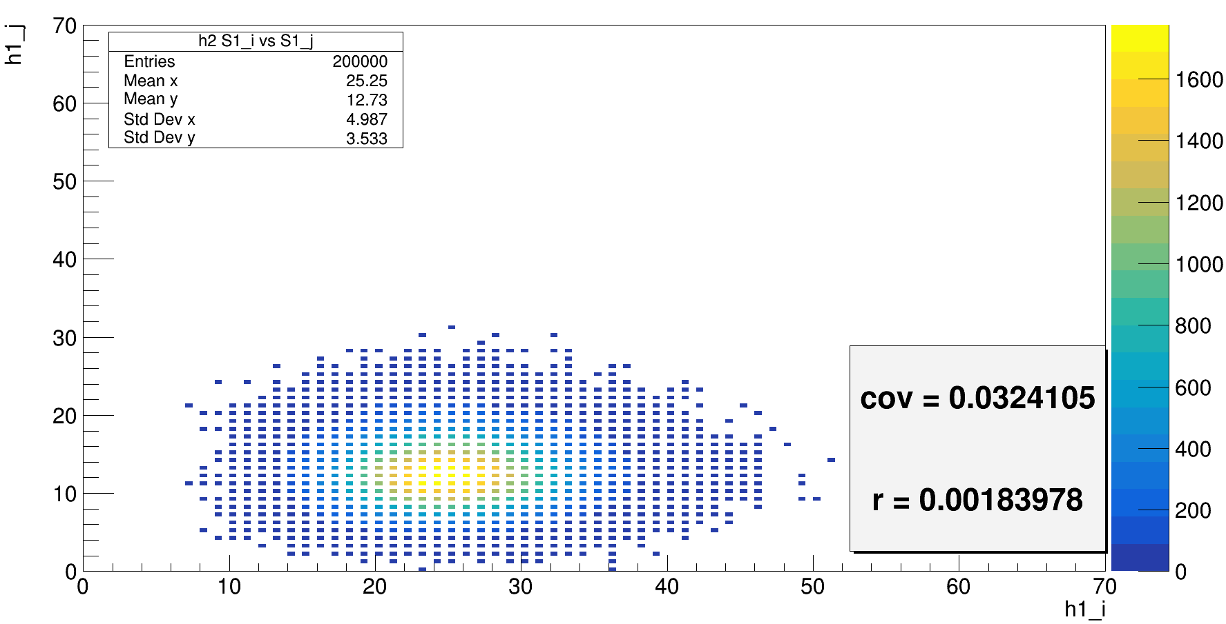
Ns = Poisson(50);
PDE1 = 1;
PDE2 = 1;
Nj0 = rndm3.Binomial(Ns - Ni0, solid_angle_part2);

Slide 16
